Slide 1
API’s and Database Connectors
Class 11

Slide 2
Agenda
Homework 3 Review
Homework 4
What’s an API?
Testing API’s
httr package & jsonlite
Database Connectors
Dbi & odbc
Deploying assignments to shinyapps.io

Slide 3
Homework 3 Review
Mean | 97.0052632
Median | 98.4
StdDev | 4.28647403

Slide 4
Homework 3 Review Cont.
There’s a difference between basemaps and normal group layers in addLayerControls()
knitr your documents before sending them to me (one time thing so not a big deal)
Cluster when you have a ton of points
Test your code before turning it in one last time!

Slide 5
Homework 4 - Due: Oct 5th
For many web applications it is important to pull information from somewhere else on the internet. For this assignment Students are expected to change their data source from a static file in their code from Homework 2 or Project 1 and replace it with the API from that resource.
Students should also address any issues brought up during the grading the assignment in question.

Slide 6
What’s an Api

Slide 7
API Examples
WPRDC
Census
Geocoders
Esri Online Datasets
Online Weather APIs
Sport Score API
And more!

Slide 8
API’s
Application Programming Interface
There are many kinds of API’s
Web service
SOAP, XML-RPC, JSON-RPC, and REST
WebSocket
Library-based
Class-based
OS functions and routines
Object remoting
Hardware

Slide 9
REST API’s
End points - different URL’s that tell the webserver what data you would like
It’s essentially a website where you request different “end points”
There are 5 types of Requests you can make
GET (what we will use the most in this course)
POST (sometimes necessary for authentication, if you’re trying to write data somewhere)
PUT
PATCH
DELETE

Slide 10
Errors
Status codes indicate the result of the HTTP request.
100’s - info
200’s - success
300’s - redirection
400’s - client error (you messed up)
500 ’s- server error (something went wrong on their end, but you still could have messed up)

Slide 11
Testing API’s

Slide 12
The Steps
Build your URL
Encode the URL
Process the content
Transform to a usable format

Slide 13
Building your Query
Many tools that make life easier
Advanced REST Client
PostMan
API Tester

Slide 14
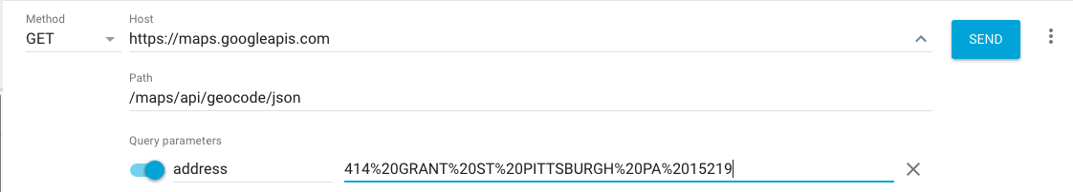
Google Geocoder API Test

Slide 15
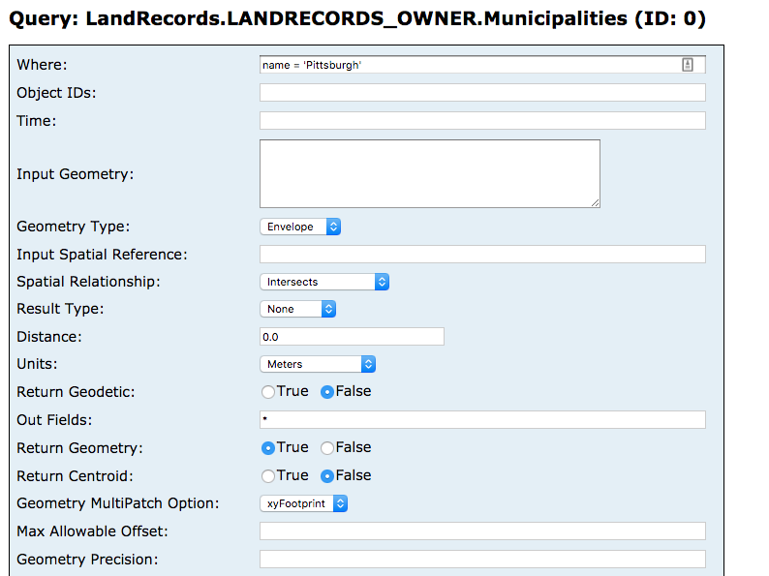
Esri tries to help you
Screenshot from Allegheny County Portal

Slide 16
Httr & jsonlite

Slide 17
The Steps
Build your URL
Encode the URL
Process the content
Transform to a usable format

Slide 18
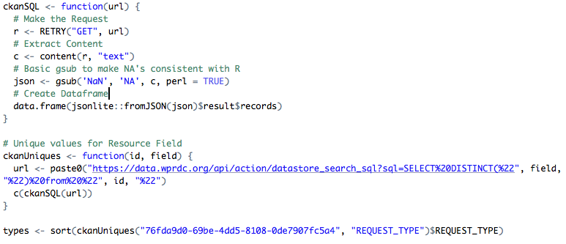
WPRDC GET Request

Slide 19
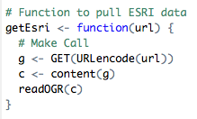
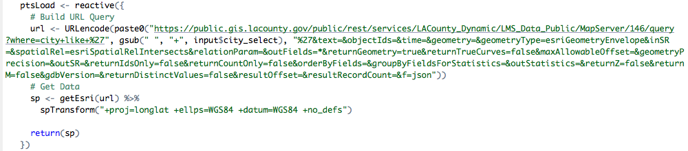
ESRI Spatial Data GET Request

Slide 20
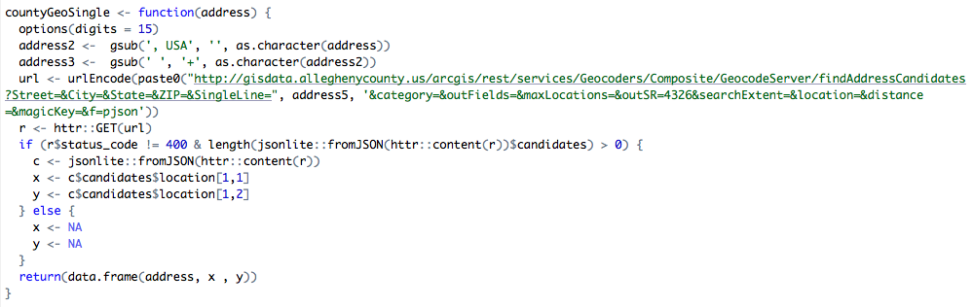
Geocoder Example

Slide 21
DBI
For local data

Slide 22
Database Connectors
First install a unixodbc driver manager
Then you have to install the correct ODBC driver
This will depend on the kind of database you are connecting to
IE: Microsoft SQL Server you can install the FreeTDS driver
Follow the directions carefully
Then you need to install the odbc and DBI r packages

Slide 23
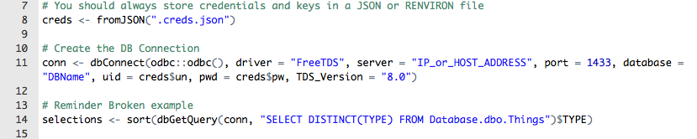
Example

Slide 24
Recommended Reading
API: https://medium.freecodecamp.org/what-is-an-api-in-english-please-b880a3214a82
httr: https://cran.r-project.org/web/packages/httr/vignettes/quickstart.html
WPRDC API Documentation: http://docs.ckan.org/en/latest/api/index.html
DBI: https://db.rstudio.com/dbi/

Slide 25
Examples

